Slide 1
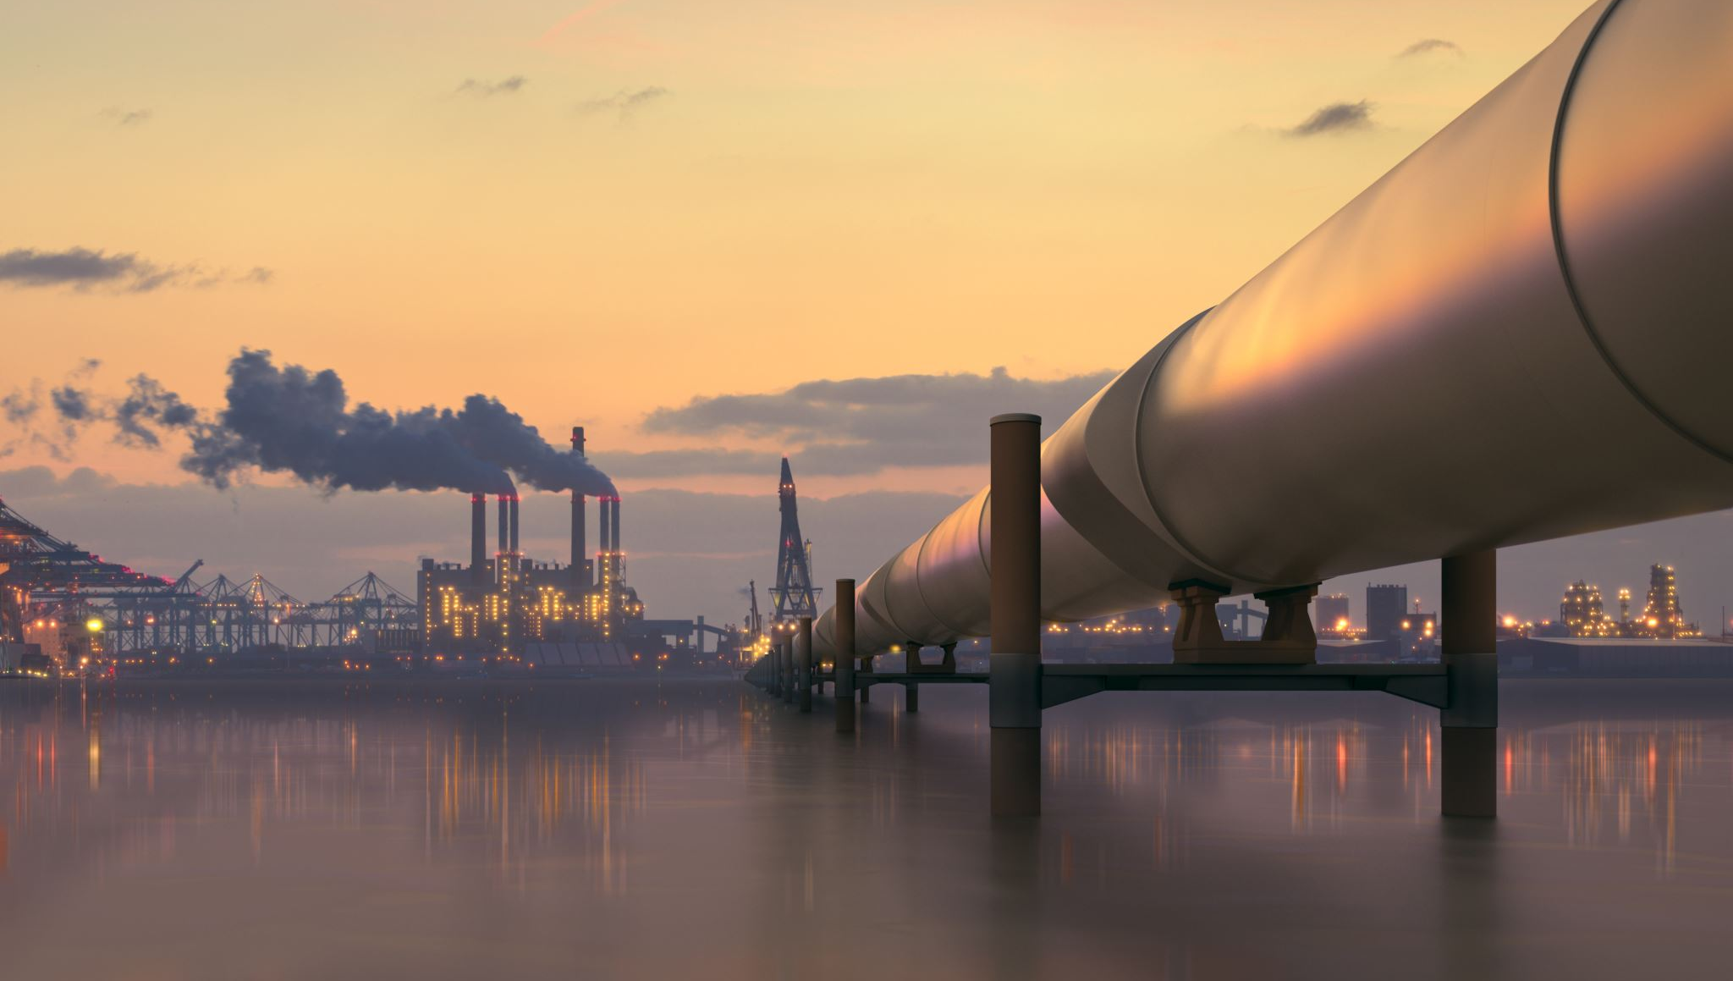
AI MODELING FOR DETECTING WATER LEAKAGE IN URBAN WATER INFRASTRUCTURE SYSTEM
Emmanuel Abel Cobbinah
CIE 500
Dr. Fan

Slide 2
CONTENT
INTRODUCTION
PROJECT OBJECTIVES
DATA
PROCESS
RESULTS
WORK TO BE DONE
RECOMMENDATION FOR FUTURE STUDIES
REFERENCES

Slide 3
INTRODUCTION
Urban water system infrastructure refers to the network of physical structures, facilities, and systems designed to manage and distribute water resources in urban areas.
Urban water infrastructure systems are critical for the sustainable management and distribution of water resources in cities.
However, these systems are often plagued by water leakage, which leads to significant economic losses, environmental damage, and reduced efficiency in water distribution
This project focuses on simulating a benchmark data to predict water leakage in urban water networks using Kentucky Water Infrastructure Data.

Slide 4
PROJECT OBJECTIVE & PROCESS
Simulate an already existing data to predict a model to detect water leakage in Urban water infrastructure system.
PROCESS
Simulate an already existing benchmark data
Create a leak in the network
Simulate the data after the leak
Predict a model for detecting leakage in urban water network.

Slide 5
DATA CHARACTERISTICS
KY 4 is a loop system within the 12 models in the Kentucky water infrastructure.
Data contain ArcGIS shapefile.
It contain 4 Tanks, 2 pumps
1,118 pipes and 939 nodes
Provides 1.51 million gallons of water to 9000 customers
The loop loses an estimate of 12% of the water distribution.

Slide 6
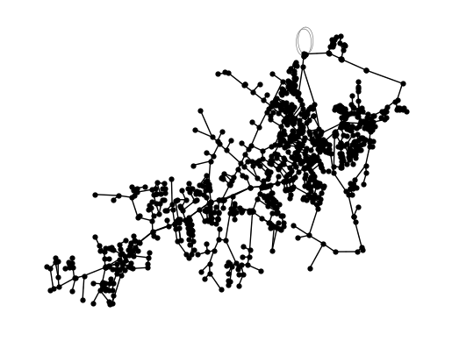
NETWORK SCHEMATICS

Slide 7
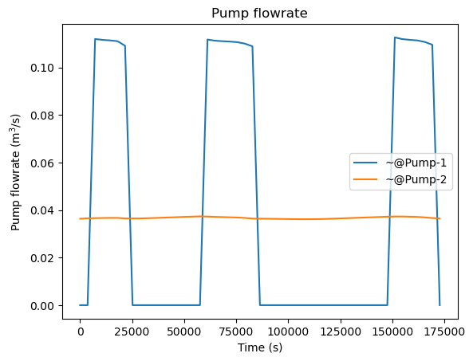
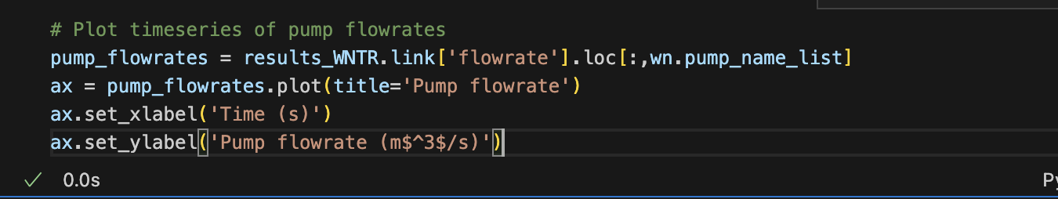
SIMULATION RESULTS
Higher flow rate expectation during daytime
Lower flowrate during nighttime
Flat zero periods indicate pump shut off

Slide 8
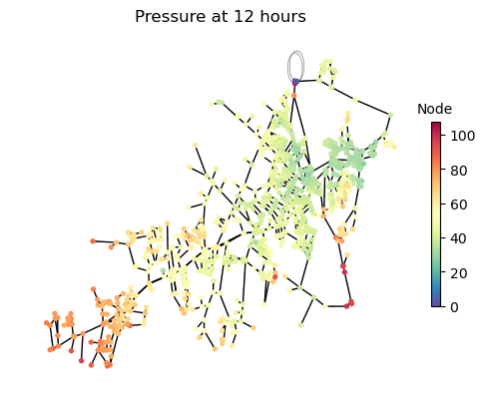
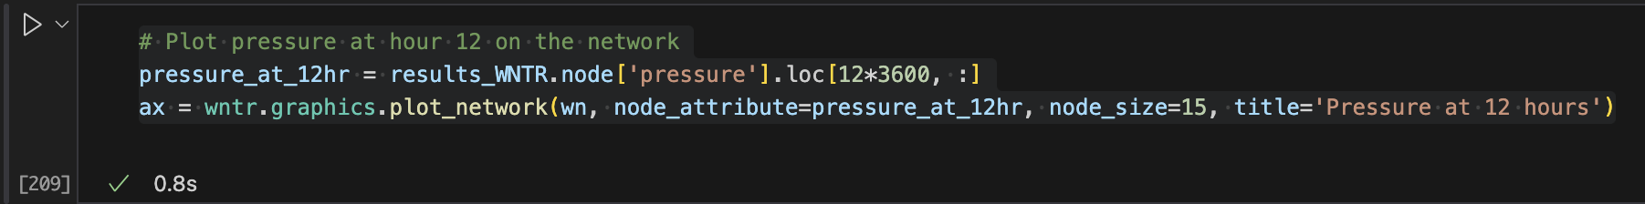
SIMULATION RESULTS
Lower pressure typically near pumps and tanks.
Higher pressure at downstream.
20-80 is typical for urban areas
< 20 indicates low pressure
> 80 indicates high pressure

Slide 9
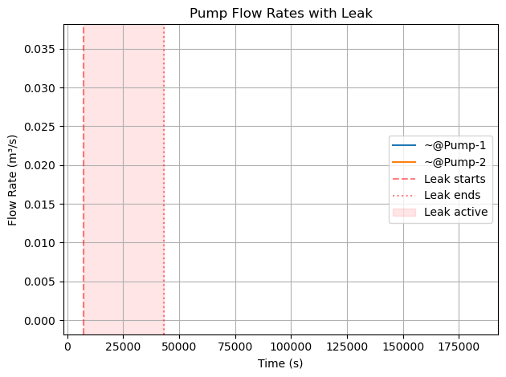
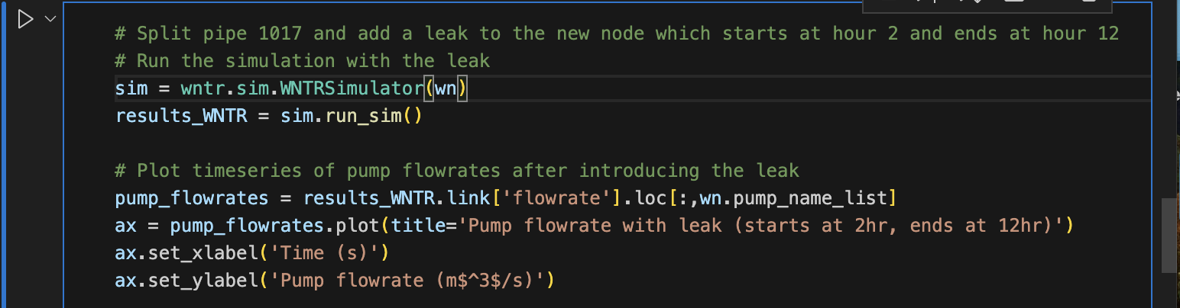
LEAK RESULTS
The leak was created at pipe P-1017
The new pipe named P-1017-A
The node where the leak was created was 1017_node
The leak started at 2 hour and ends at the 12 hour
Expected pressure drop at the leak node
Expected increased flow rate to compensate for water lost through leaks.

Slide 10
WORK TO BE DONE
Simulating the data after leak to analyze the flowrate and pressure.
Compare the flow rate and pressures before and after the leak.

Slide 11
FUTURE WORK & CONCLUSION
Extend simulation to complex networks by creating multiple leaks.
AI models can help automate leak detection and reduce energy loss in urban water infrastructure.

Slide 12
REFERENCES
Suwatthikul, J., Oumtrakul, N., & Anusart, K. (2022). AI-based acoustic leak detection in water distribution systems. Results in Engineering, 15, 100557
Cantos, W. P. (2018). Artificial intelligence application for leak detection and geolocation in water distribution systems (Publication No. 10935276) [Doctoral dissertation, New York University Tandon School of Engineering]. ProQuest Dissertations Publishing.
Abdelmageed, S., Tariq, S., Boadu, V., & Zayed, T. (2022). Criteria-based critical review of artificial intelligence applications in water-leak management. Environmental Reviews, 30(3), 280-297.
Wu, Y., Liu, S., & Kapelan, Z. (2024). Addressing data limitations in leakage detection of water distribution systems: Data creation, data requirement reduction, and knowledge transfer. Water Research, 267, 122471.

